Slide 1
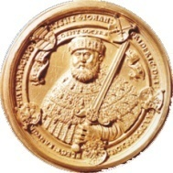

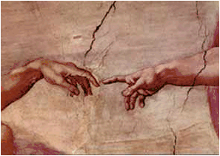





Thermal Noise and Material Related Issues
Ronny Nawrodt¹, Iain Martin²
23/08/2011
¹Friedrich-Schiller-Universität Jena, Germany
²SUPA University of Glasgow, Scotland

Slide 2
Overview
thermal noise in GW detectors (revision)
important material properties
mechanical loss measurements
bulk
coatings
(optics…)
summary

Slide 3
Thermal noise in GW detectors

Slide 4
Thermal noise in GW detectors
GW detectors are amongst the most sensitive tools today.
operation at the technical and scientifical limitations (noise, cross coupling, etc.)
improving the instruments means fighting with physics
novel techniques (setups, cryogenics, etc.)
novel materials (change of material for optical components)
…

Slide 5
Thermal noise in GW detectors
The first generation of interferometric GW detectors (LIGO, Virgo, GEO600, TAMA300) reached their design sensitivities in a wide range of frequencies.

Slide 6
Thermal noise in GW detectors
current detectors are based on:
fused silica optics (best optical material currently available)
fused silica or metal suspensions
friction between the suspension and the optics can be avoided by using the low mechanical loss jointing technique of hydroxide catalysis bonding

Slide 7
Thermal noise in GW detectors
Currently, the second generation of GW detectors is being built based on the experiences of the first generation of GW detectors and novel techniques that have been tested.
further improvements:
aLIGO, aVirgo, GEO-HF fused silica, room temperatur,
monolithic suspensions (demonstrated in GEO600 for years)
LCGT + CLIO sapphire, cryogenics
pioneering work in the field of cryogenic large scale interferometry

Slide 8
Thermal noise in GW detectors
As the second generation is designed and currently about to being built researchers started a conceptual design study for a 3rd generation detector – the Einstein Telescope design study.
aims:
What technologies are needed to increase sensitivity by a factor of 10 compared to 2nd generation?
How might such a design look like?
Which materials should be used? Which design?
(How much does it cost?)
homepage: www.et-gw.eu

Slide 9
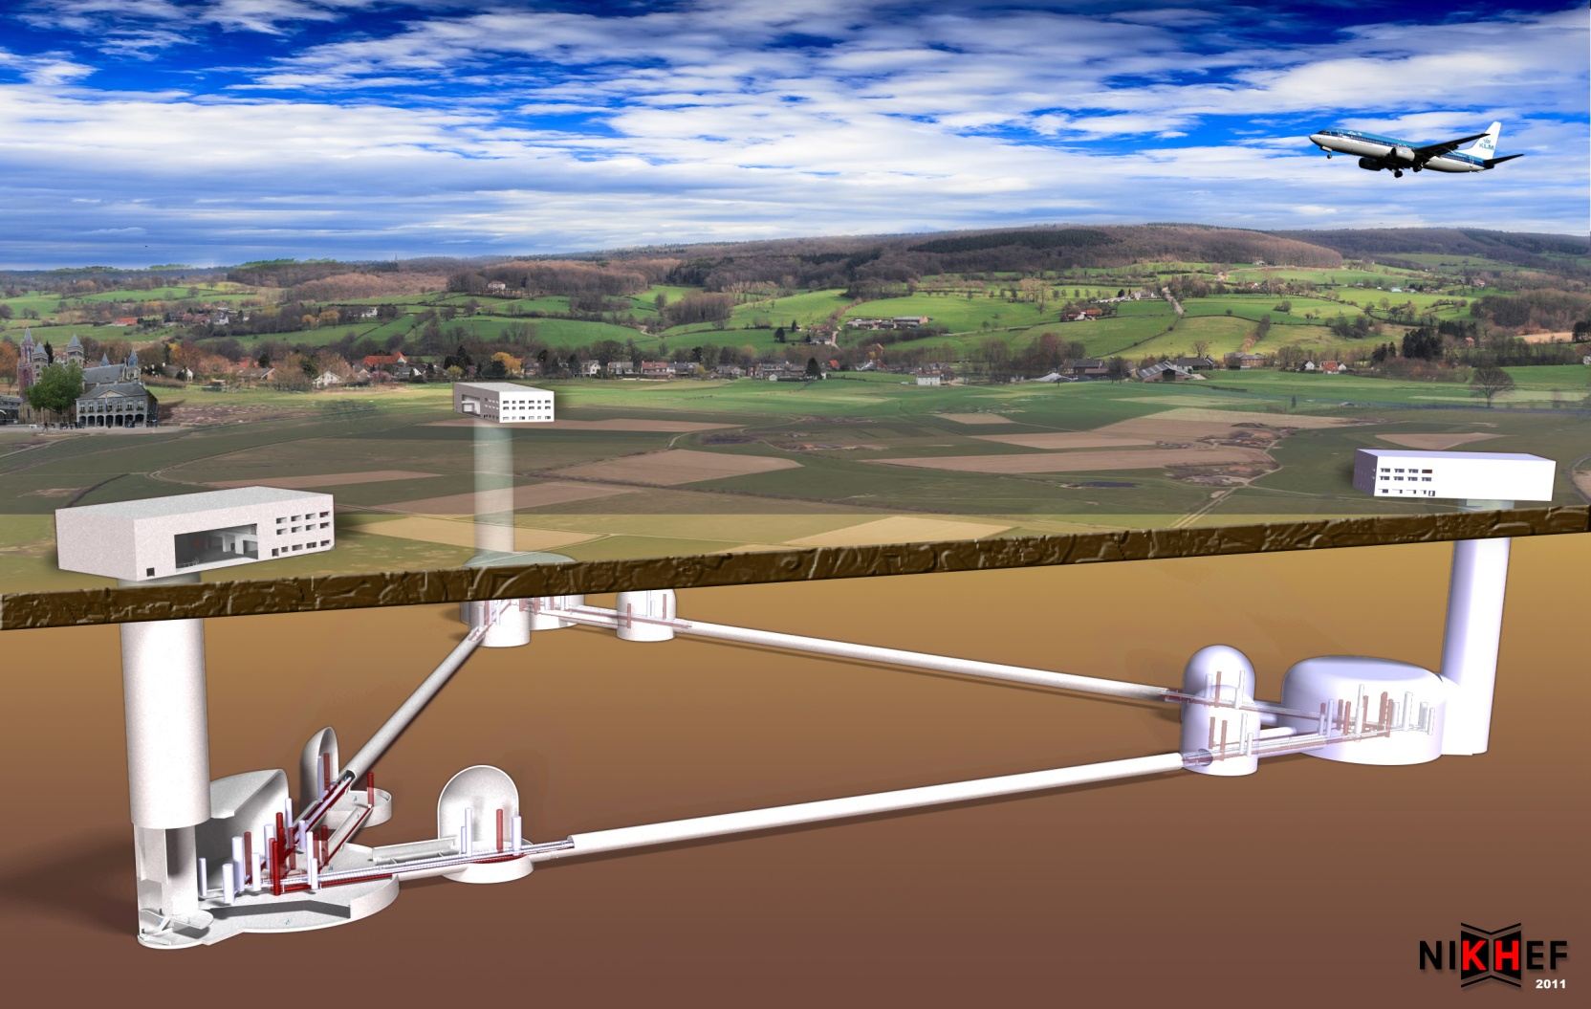
Thermal noise in GW detectors
artist view of ET – check www.et-gw.eu for details

Slide 10
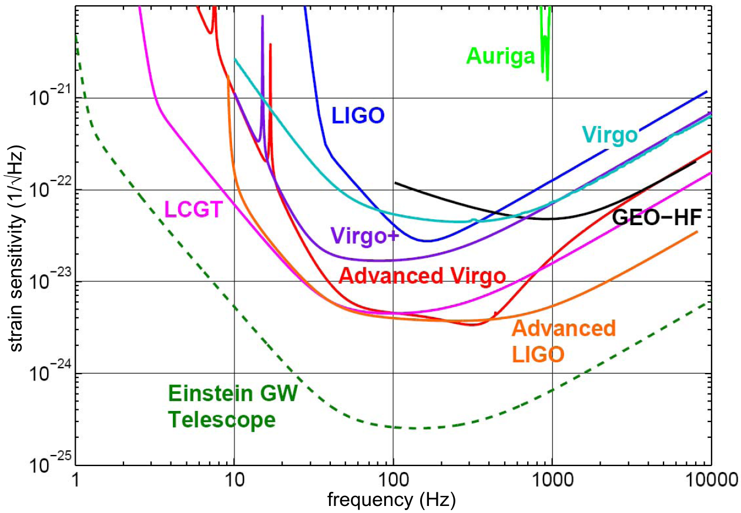
Thermal Noise in GW detectors
improvement of the sensitivity between different generations of GW detectors:

Slide 11
Thermal noise in GW detectors
Parts of the Einstein Telescope have to be operated at cryogenic temperatures to reduce thermal noise.
natural links between ET and LCGT:
cryogenics
pulse tube vs. LHe cooling
contamination of the mirrors due to cryotrapping
general: pioneering technology in cryogenics
people exchange between Japanese and Einstein Telescope researchers now extended through personal exchange program

Slide 12
Thermal noise in GW detectors
a reminder of thermal noise:
two different types
(1) fluctuating thermal energy → Brownian thermal noise
(2) fluctuating temperature → thermo-elastic, thermo-
refractive, thermo-optic
temperature dependent parameter (e.g. CTE, dn/dT) links temperature fluctuation and phase fluctuation of the detector

Slide 13
Thermal noise in GW detectors
a reminder of bulk thermal noise
main message: material properties influence strongly the thermal noise – (nearly) all of them are temperature dependent
α=0 possible for some materials, e.g. silicon (@ 18 and 125 K)
Thermo-elastic noise:
Brownian thermal noise:
beam diameter
temperature

Slide 14
Thermal noise in GW detectors
a reminder of bulk thermal noise
similar with thermo-optical noise and finite corrections
Thermo-elastic noise:
Brownian thermal noise:
beam diameter
temperature

Slide 15
Material properties

Slide 16
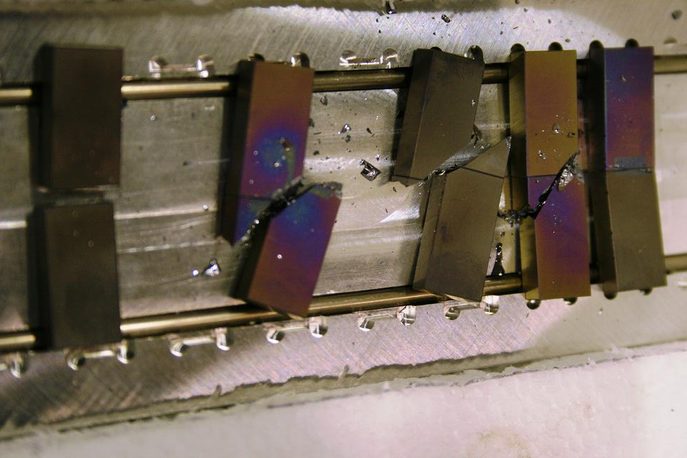
Overview of material properties
mechanical properties
basic property: strength of the material (especially for suspension elements)
[IGR Glasgow]

Slide 17
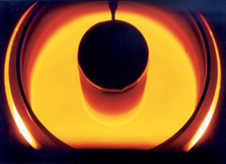
Overview of material properties
mechanical properties
Young‘s modulus, Poisson ratio
mass density of the material
available size
(growing methods)
optimum crystal orientation
mechanical loss to determine Brownian thermal noise
(= main focus of this lecture)
[Wacker]

Slide 18
Overview of material properties
thermal properties
strongly temperature dependent
crystalline materials follow „basic“ thermodynamics / statistics
(Debye theory)
heat capacity (~ T³ at low temperatures for crystals)
thermal conductivity (removal of heat!)
coefficient of thermal expansion

Slide 19
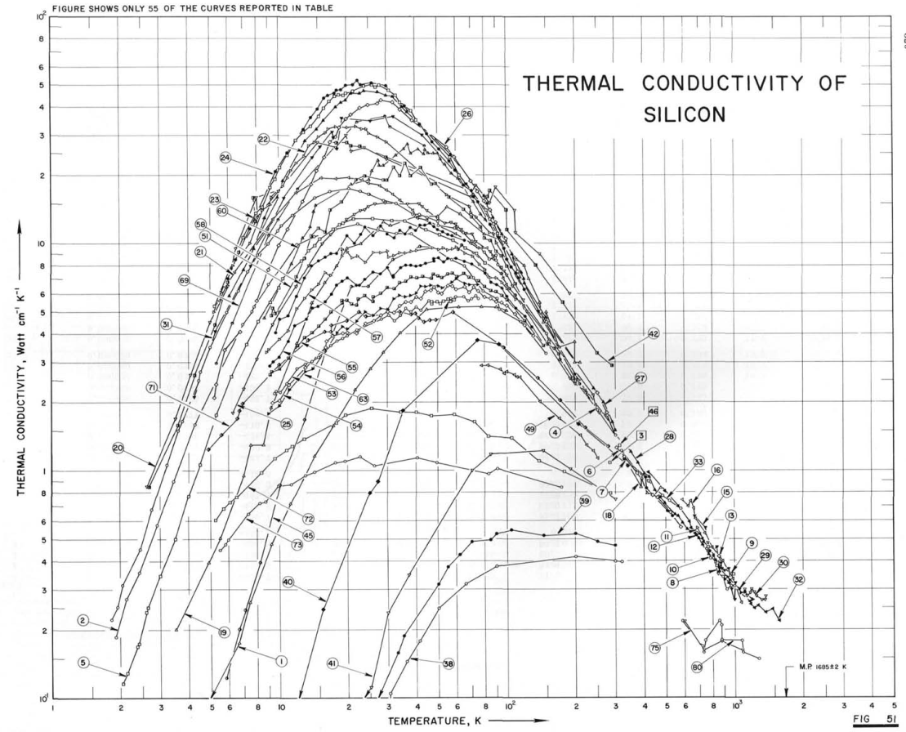
Overview of material properties
thermal properties
thermal conductivity
increasing impurity
concentration (scattering
of phonons on impurities)
+ size effects (boundary scattering)
log scale →
not enough phonons left
to carry heat
[Touloukian]
log scale →

Slide 20
Overview of material properties
thermal properties
coeffcient of thermal expansion
larger CTE for cryst. materials compare to amorphous (reason: summation of tiny effects in the crystal)
usually CTE decreases with decreasing temperature
some materials show temperatures with CTE = 0
(e.g. silicon @ 18 and 125 K)

Slide 21
Overview of material properties
optical properties
refractive index n
forming HR mirror coatings
thermo-refractive coefficient dn/dT
determines the thermo-refractive noise
optical absorption α
sets a fundamental limit to the minimum operational temperature

Slide 22
Mechanical loss
- Introduction -

Slide 23
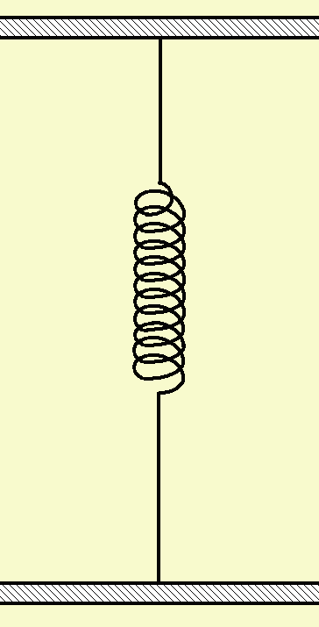
Basics of mechanical loss
elastic behaviour of a solid
Hook‘s Law
… stress
… strain
E … Young‘s modulus
(German: modulus of elasticity)
instantaneous reaction, full recovery

Slide 24
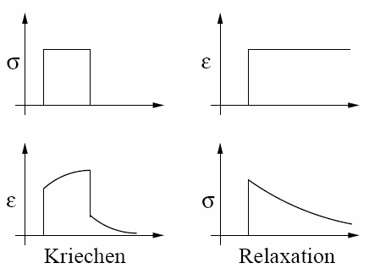
Basics of mechanical loss
anelastic behaviour of a solid
anelasticity
relaxation
only partial instantaneous reaction, full recovery after t = ∞

Slide 25
Basics of mechanical loss
periodic process – anelasticity and mechanical loss
hysteresis
(= energy loss)
work
done by the
system
work
done on the
system

Slide 26
Basics of mechanical loss
isothermal
adiabatic
energy dissipation per cycle
frequency f

Slide 27
Basics of mechanical loss
definition of the mechanical loss = phase lag between stress and strain
measurement via the mechanical Q-factor at a resonance
keep in mind:
The mechanical loss is a continuous function of frequency but we just probe it at certain frequencies (resonant frequencies) of a system → no full knowledge available.

Slide 28
Loss mechanisms
There are many different origins of loss in solids.
Focus on 3 dominant ones:
phonon-phonon interaction
thermo-elastic loss
impurity driven losses
Phonon-phonon-damping (Akhiezer-/Landau-Rumer-Damping)
Phonons are forming a certain distribution when in equilibrium. At low frequency excitations the acoustic vibration (= phonon) modulates the lattice → new local
equilibrium → redistribution consumes energy → loss.

Slide 29
Loss mechanisms
Phonon-phonon-damping (Akhiezer-/Landau-Rumer-Damping)
Phonons are forming a certain distribution when in equilibrium. At low frequency excitations the acoustic vibration (= phonon) modulates the lattice → new local
equilibrium → redistribution consumes energy → loss.
(Akhiezer loss)
If the phonon energy is high (high frequency vibration) the acoustic phonon directly interacts with the phonons of the given distribution → direct phonon scattering → redistribution consumes energy → loss.
(Landau-Rumer-Loss)

Slide 30
Basics of mechanical loss
thermo-elastic damping
If a sample is deformed certain parts will be compressed or
expanded → local heating or cooling (depending on CTE).
Sample is now in thermal non-equilibrium → heat flux → entropy is increased → loss.
impurity driven damping
Impurities can occupy different positions in a lattice
depending on the applied stress. If an external vibration
is applied it might be energetic better to change positions → loss.

Slide 31
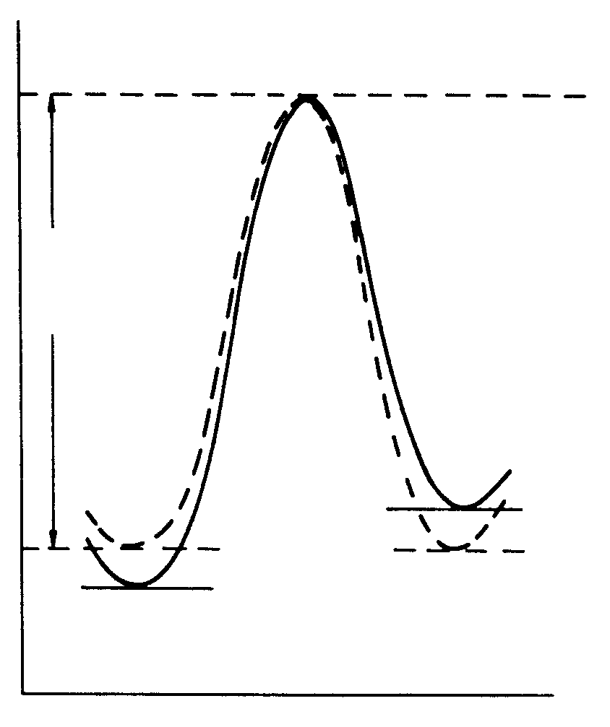
Basics of mechanical loss
The transition between 2 (quasi-)stable positions can be modelled with a double-well potential:
E_{A}
„Debye peak“
energy
Δ … relaxation strength
τ … relaxation time
σ≠0
thermally activated process:
σ=0
position
E_{A} … activation energy
τ₀ … relaxation constant

Slide 32
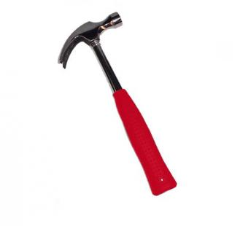
Basics of mechanical loss
ring-down measurements
bandwidth measurements
f₀
amplitude
amplitude
Δf
time
frequency

Slide 33
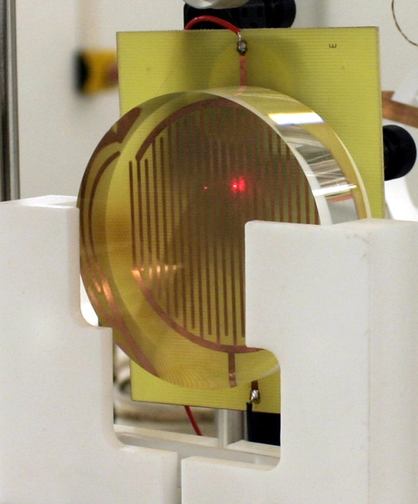
Basics of mechanical loss
excitation of modes
mechanical (e.g. piezo)
electro-static
vibration read-out
electrical read-out (capacitor)
optical read-out (e.g. optical lever,
interferometric techniques)
+
+
-

Slide 34
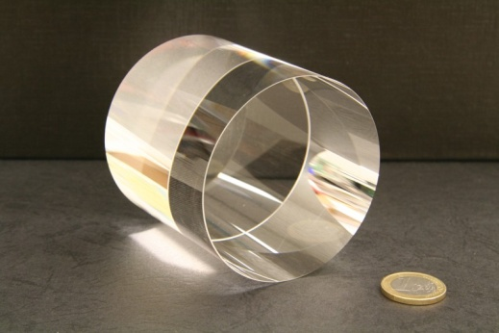
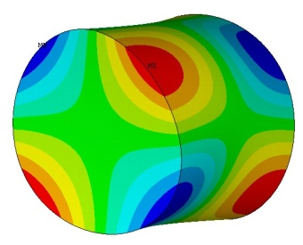
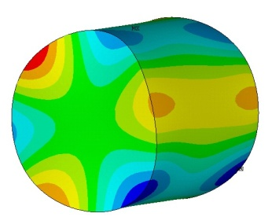
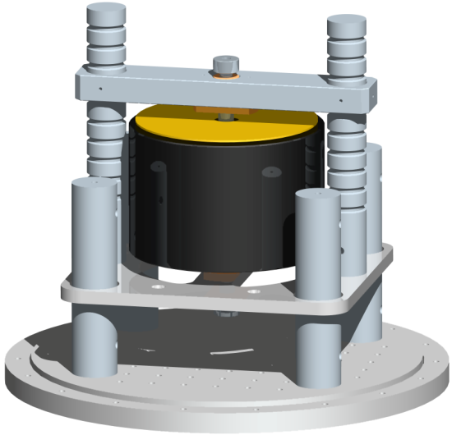
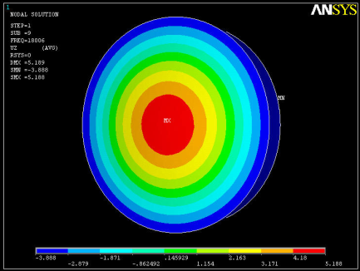
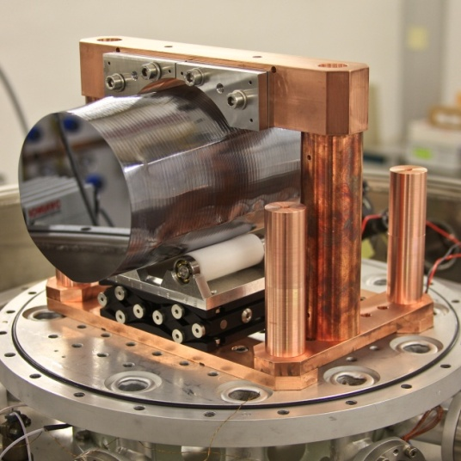
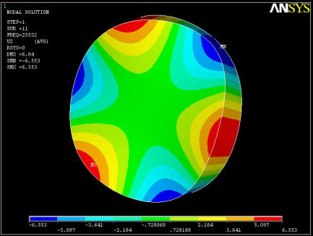
Mechanical loss
- Bulk Materials -

Slide 35
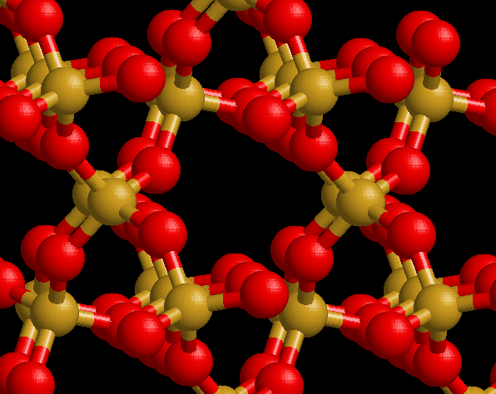
Selected examples - Quartz
crystalline quartz is well known → toy material to investigate setups and data processing tools
silicon
hydrothermal growth of crystal
grown from solution under pressure
(~ 500 bar) at elevated temperatures
containing:
water
silicon dioxide
sodium carbonate / hydroxide
oxygen
cryst. quartz shows channels along its c-axis

Slide 36
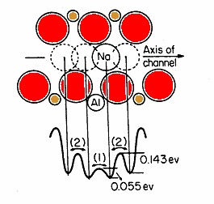
Selected examples - Quartz
impurities trapped in multiple well potential
along the c-axis
loss peaks associated with sodium
Si
O
loss process is orientation dependent
detailed study needs different cryst.
cuts from the same material
activation energy from experiment:
~ 55 meV

Slide 37
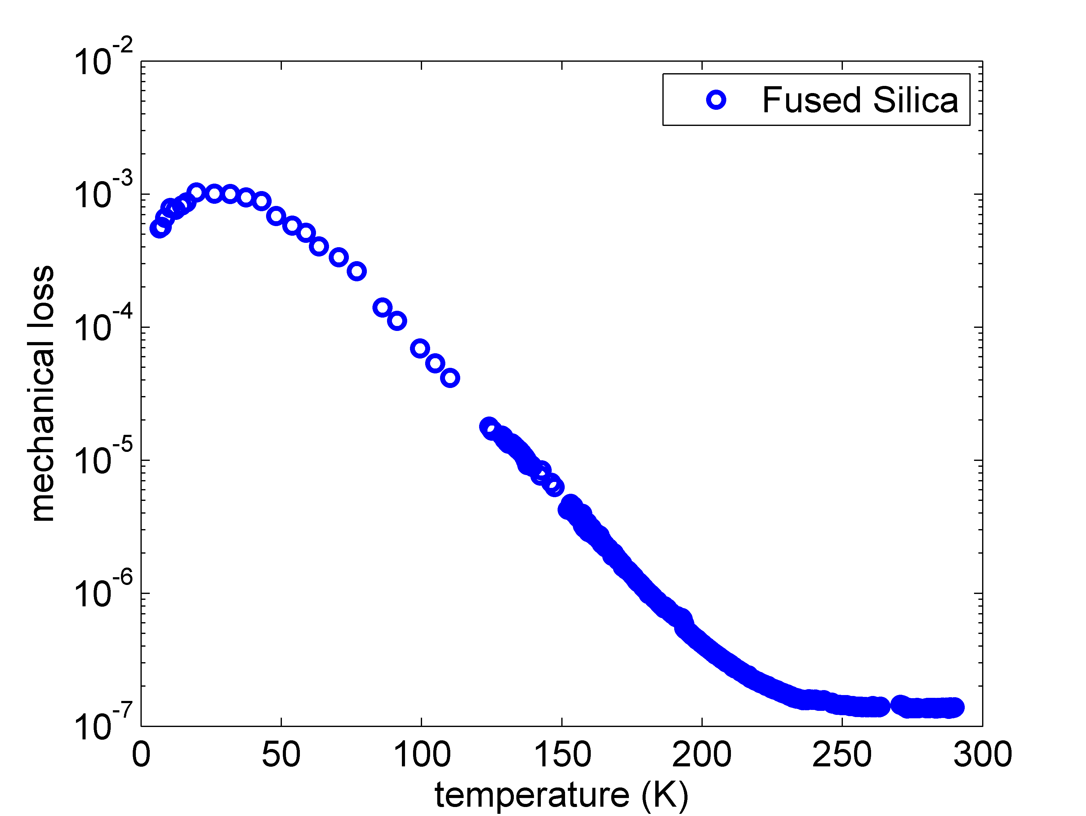
Selected examples – Fused Silica
fused silica:
very low loss at room temperature reaching 4×10⁻¹⁰
large loss peak around 30K
not suited for cryogenic
use in GW detectors
origin of the peak:
Amorphous silica has a near but no far order. Thus, loss processes get a distribution of loss parameters. The peak is the superposition of all of them.

Slide 38
Selected examples – Sapphire/Silicon
crystalline materials needed for cryogenic operation
different candidate materials have been discussed in the past
possible candidate materials are sapphire (LCGT) and Si (ET)
reasons:
both are optical materials (remember, FS is currently the best optical material)
both are available in rather large pieces
high thermal conductivity
coating techniques available
while sapphire can be operated at 1064nm silicon demands a change of the laser wavelength due to its optical absorption

Slide 39
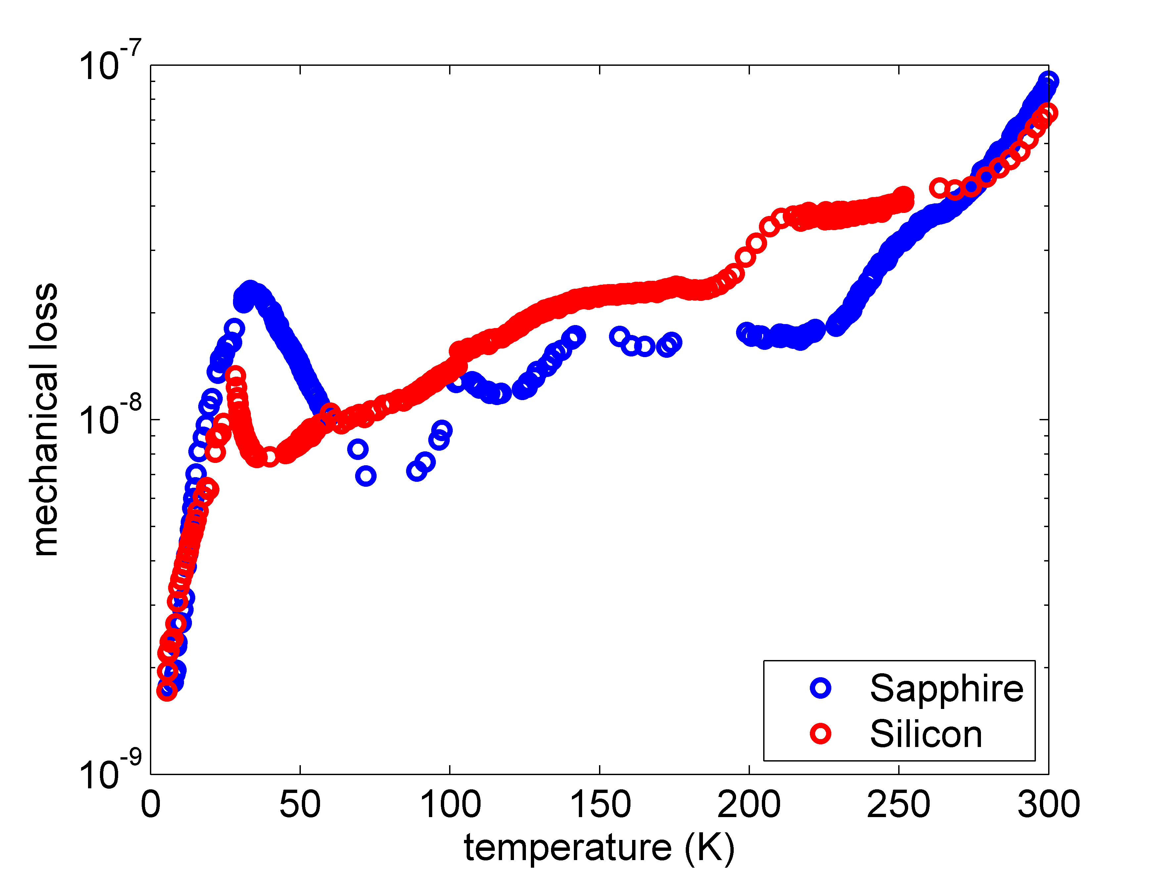
Selected examples – Sapphire/Silicon
mechanical loss of silicon and sapphire is comparable at cryogenic temperatures (Q‘s up to several 10⁹ achieved)
test measurement of silicon
and sapphire samples
[U Jena]

Slide 40
Selected examples – Sapphire/Silicon
detailed investigation of intrinsic loss mechanisms in promising candidate bulk materials ongoing
questions:
general loss processes?
impurities? tolerable level of impurities?
heat treatment to remove dislocations?
surface loss?
…
collaboration of several groups (Jena, Glasgow, Legnaro, starting collaboration with Japan) to investigate intrinsic damping of materials (coatings, bulk, surfaces, etc.)

Slide 41
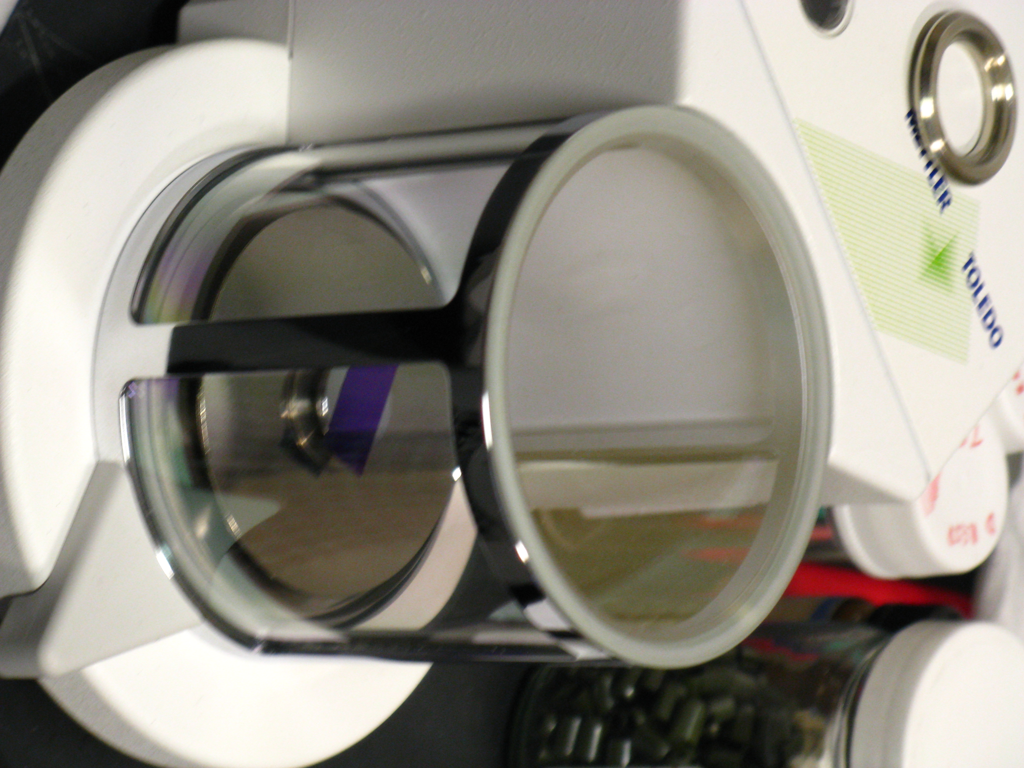
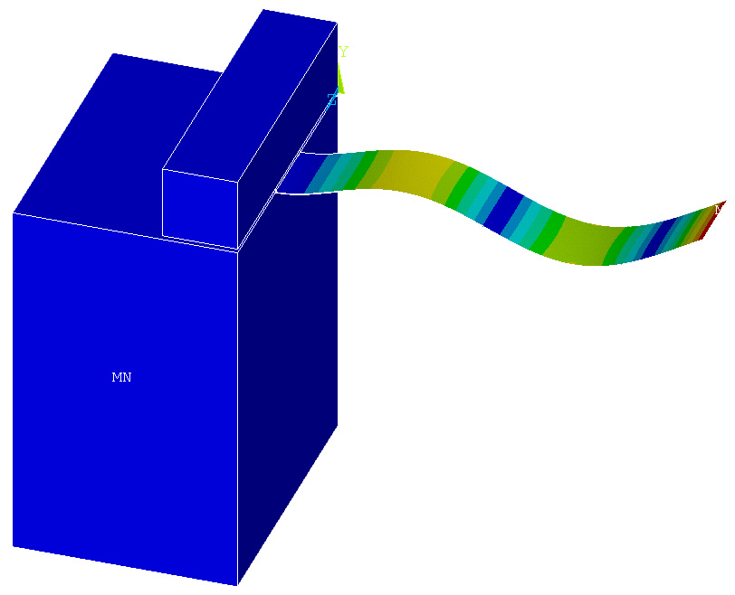
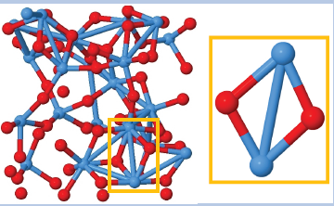
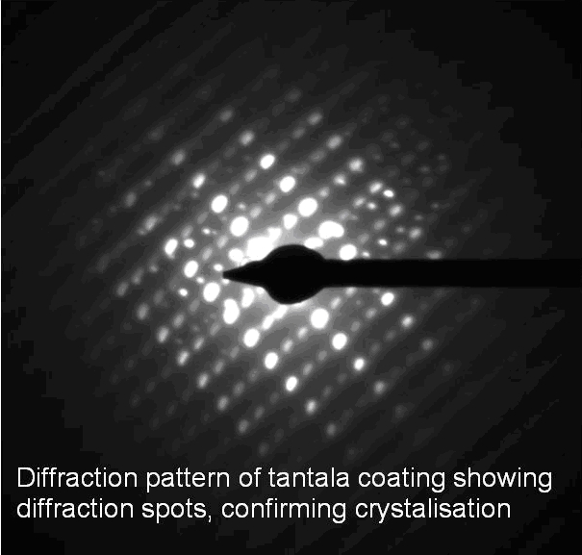
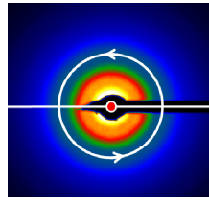
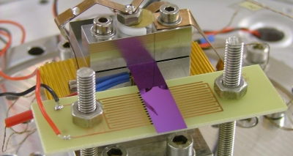
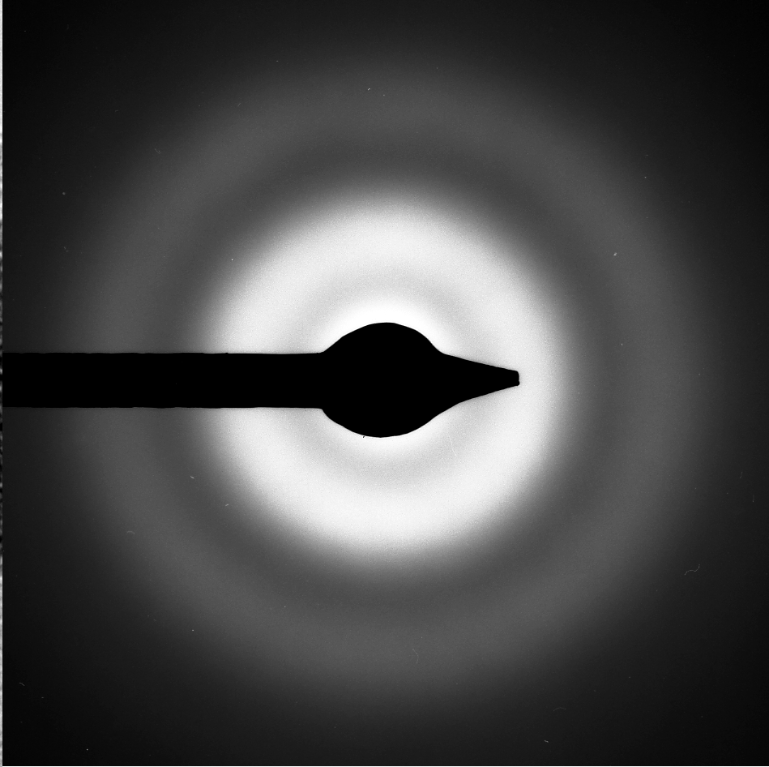
Mechanical loss
- Coating Materials -

Slide 42

Optical coatings
Requirements – high reflectivity, low optical absorption (< 1ppm)
Multilayer coatings of dielectric materials, λ/4 thick
Reflectivity from difference in refractive index, and number of layers, 2N.
Current detectors use silica (n=1.45) / tantala (n=2.03) coatings, ~ 15 bi-layers

Slide 43
Coating thermal noise
Levin – interferometer most sensitive to mechanical loss close to the reflected laser beam
Thus mechanical loss of coatings is particularly important
Coating loss dominated by the loss of the tantala layers
φ_{tantala} ~ 4×10⁻⁴
φ_{silica}~ 5×10⁻⁵
Measurements suggested no observable loss from coating layer interfaces (however recent results from LMA, Lyon, suggest some interface loss may be observable)
Doping Ta₂O₅ with TiO₂ can reduce the loss by ~40%.

Slide 44
Coating thermal noise
Coating thermal noise
Coating thermal noise expected to limit achievable sensitivity of future GW detectors at their most sensitive frequencies

Slide 45
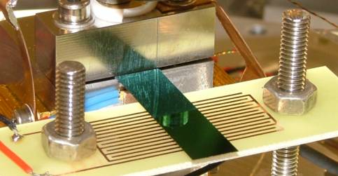
Coating loss measurements
First cryogenic measurement of silica/tantala coating by Yamamoto et al, showed possible slight increase in loss at low temperature
Cryogenic loss studies of mono-layers of individual coating materials carried out in collaboration between Glasgow, Jena, LMA
Study individual materials in isolation
Identify microscopic dissipation mechanisms
Test coating performance at cryogenic temperatures
Single layer coatings of silica (left) and tantala (right), clamped for loss measurements

Slide 46
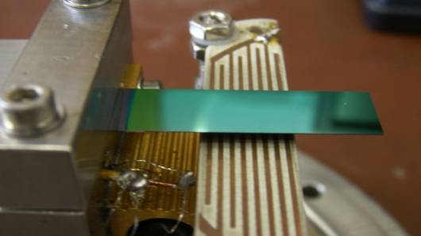

Measuring coating loss - 1
Single layers of a coating material applied to silicon cantilever substrates
Loss measured from exponential ring-down of bending modes
34mm
50μm thick
Coating applied here
500μm
electrostatic
drive
tantala coating
coated cantilever in clamp within cryostat
bending modes excited via eletrostatic drive
loss from free decay of amplitude

Slide 47
Measuring coating loss - 2
(c)
Loss of coating layer calculated from difference in loss of a coated and un-coated cantilever
Scaling factor accounts for fraction of total elastic energy stored in the coating
(b)
(a)
Loss of (a) uncoated silicon cantilever with thermal oxide layer, (b) cantilever coated with 500 nm of TiO₂-doped Ta₂O₅ (14.5% Ti) and (c) the calculated loss of the coating layer

Slide 48
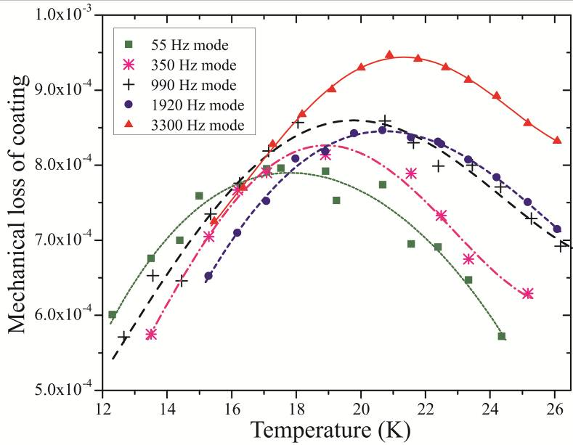
Loss peak analysis - tantala
Debye-like mechanical loss peaks
thermally activated process
Δ … relaxation strength
τ … relaxation time
E_{A} … activation energy
τ₀ … relaxation constant
double well potential
without external stresses

Slide 49
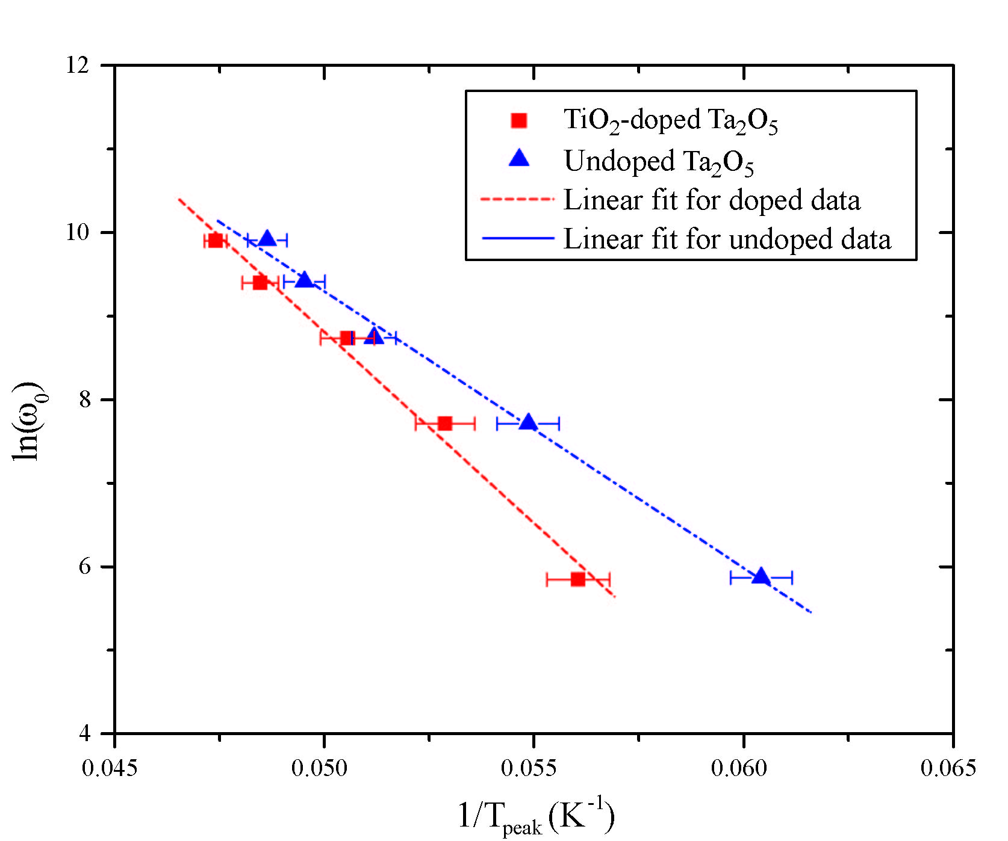
Loss mechanism parameters – Arrhenius plot
Activation energy
(40 ± 3) meV for TiO₂ doped Ta₂O₅
(29 ± 2) meV for undoped Ta₂O₅
Doping with TiO₂ increases the activation energy.
Transition between two stable states appears to be hindered

Slide 50
Possible microscopic processes
no long-distance order in coating materials (amorphous)
possible transitions of atoms / atom groups
doping might block possible positions → increase of activation energy
O
O
Ta
Ta
Ta
Ta
O
Ti

Slide 51
Distribution of model parameters
Debye loss peak plotted using calculated activation energy and relaxation constant
Much narrower than experimental peak
Amorphous structure results in a distribution of activation energies.

Slide 52
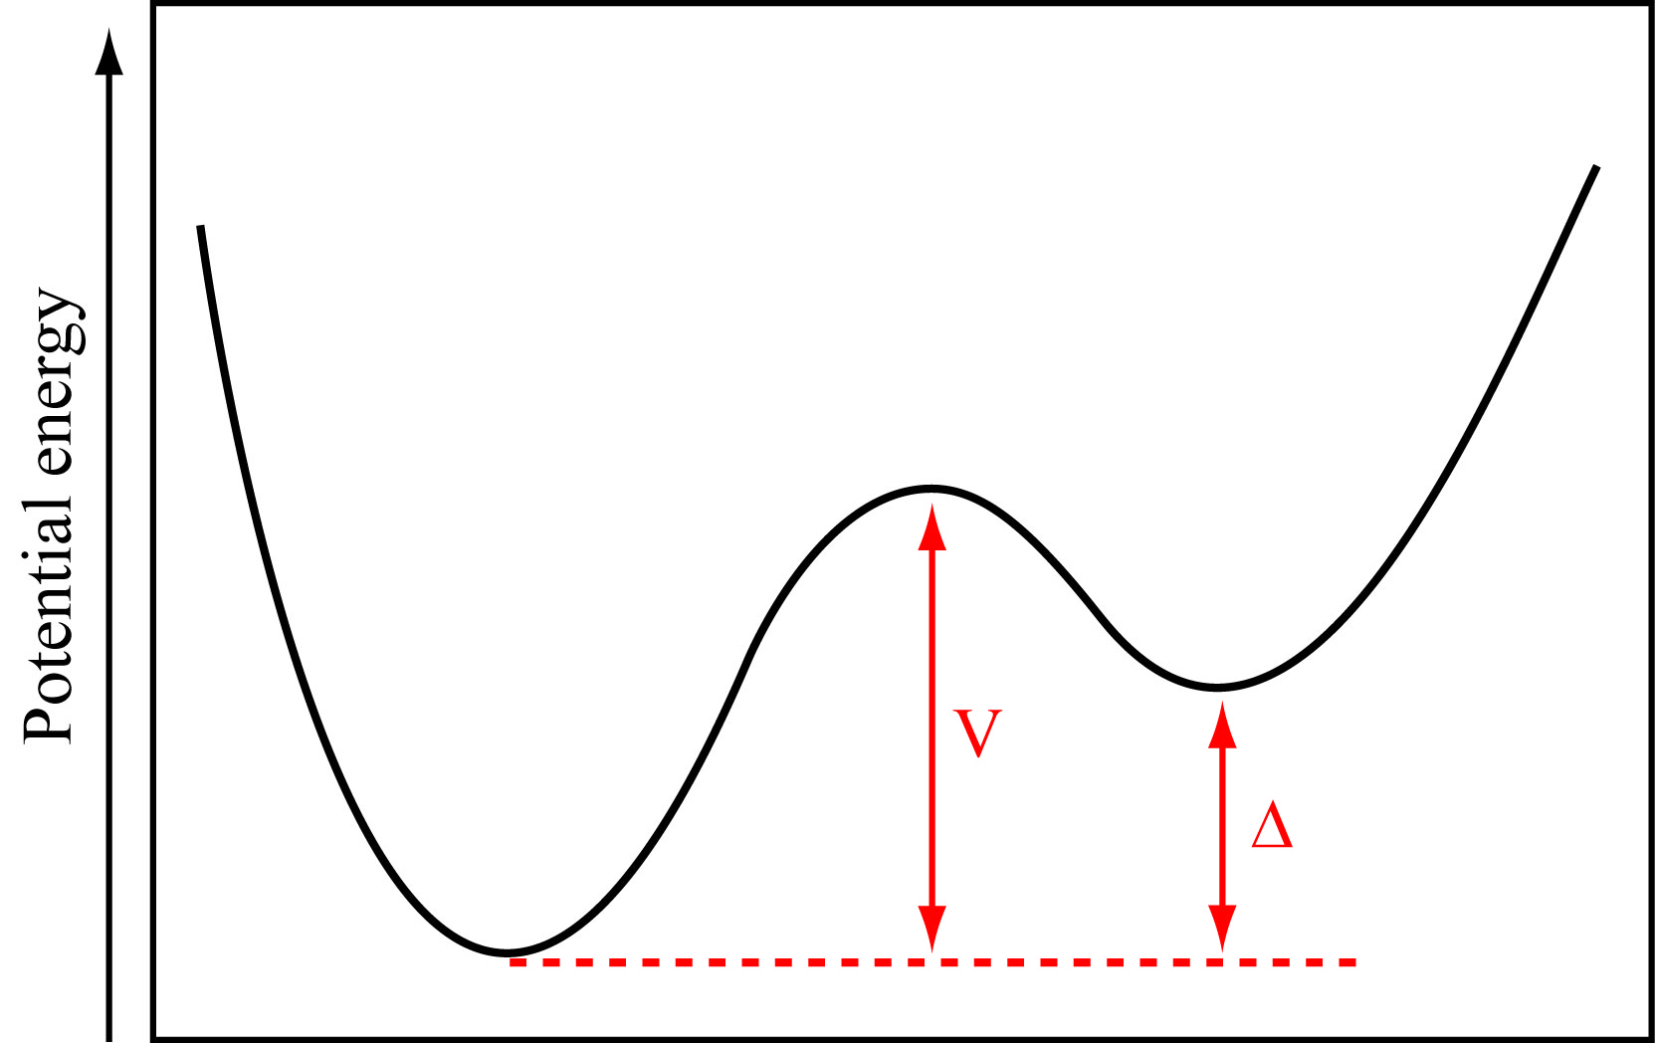
Distribution of parameters
refined model:
asymmetric double-well
potential
barrier height distribution g(V)
asymmetry distribution f(Δ)
[Gilroy, Phillips 1981]
γ represents the coupling between strain and the dissipation mechanism
C_{ii} is the elastic constant of the material

Slide 53
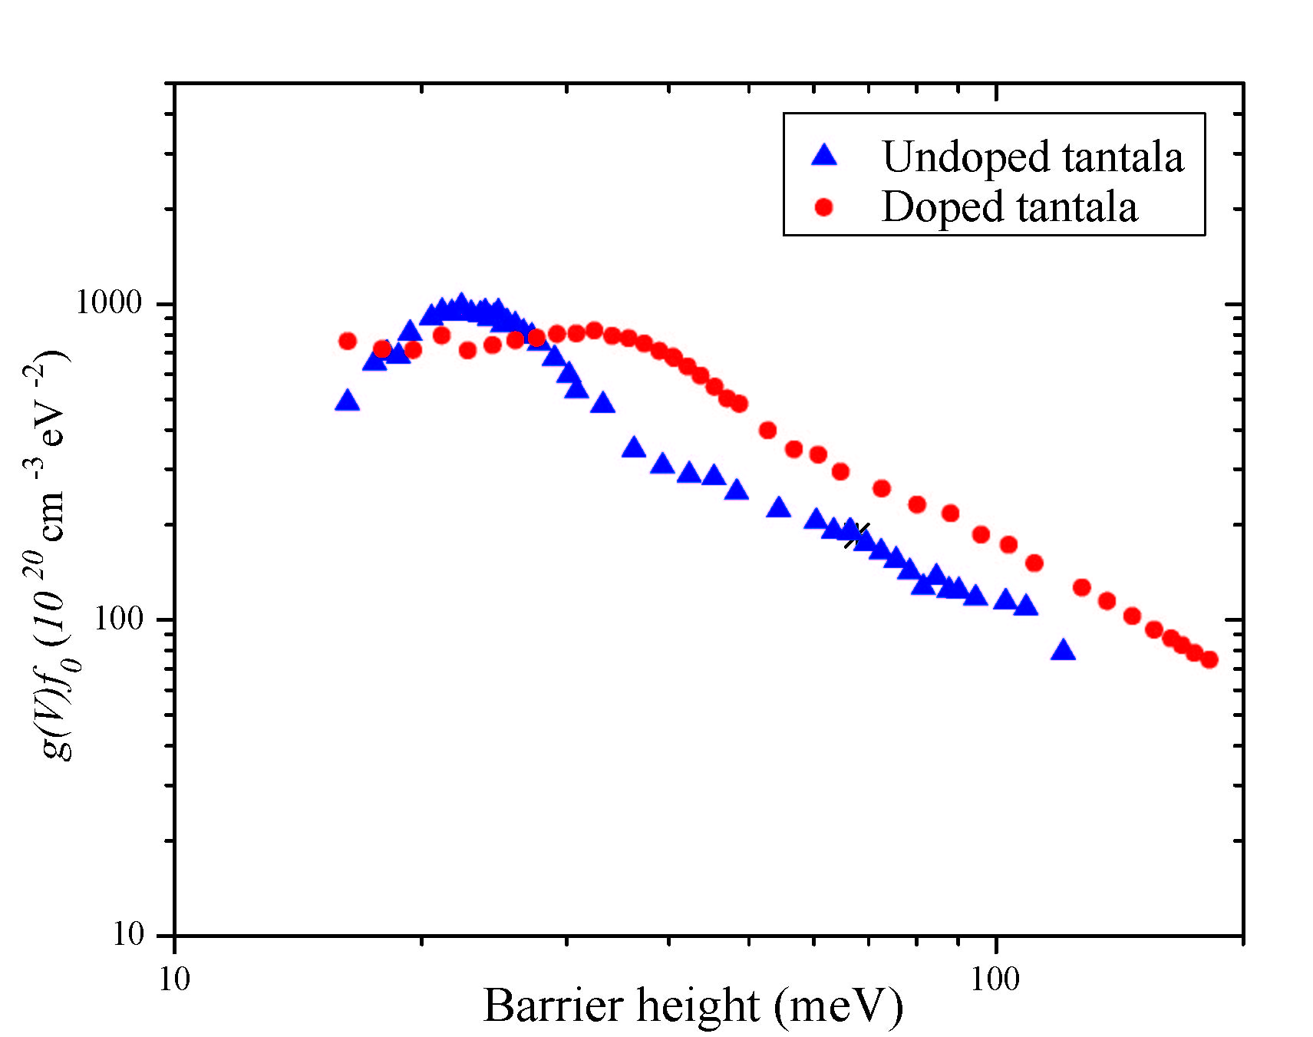
Distribution of barrier heights
asymmetric double well potential:
barrier height distribution
contains information about
the microscopic structure
doping changes height and
distribution of barrier heights
[Gilroy, Phillips 1981]
g(V) … barrier height distribution
g(V)f₀
[Martin et al. 2009]

Slide 54
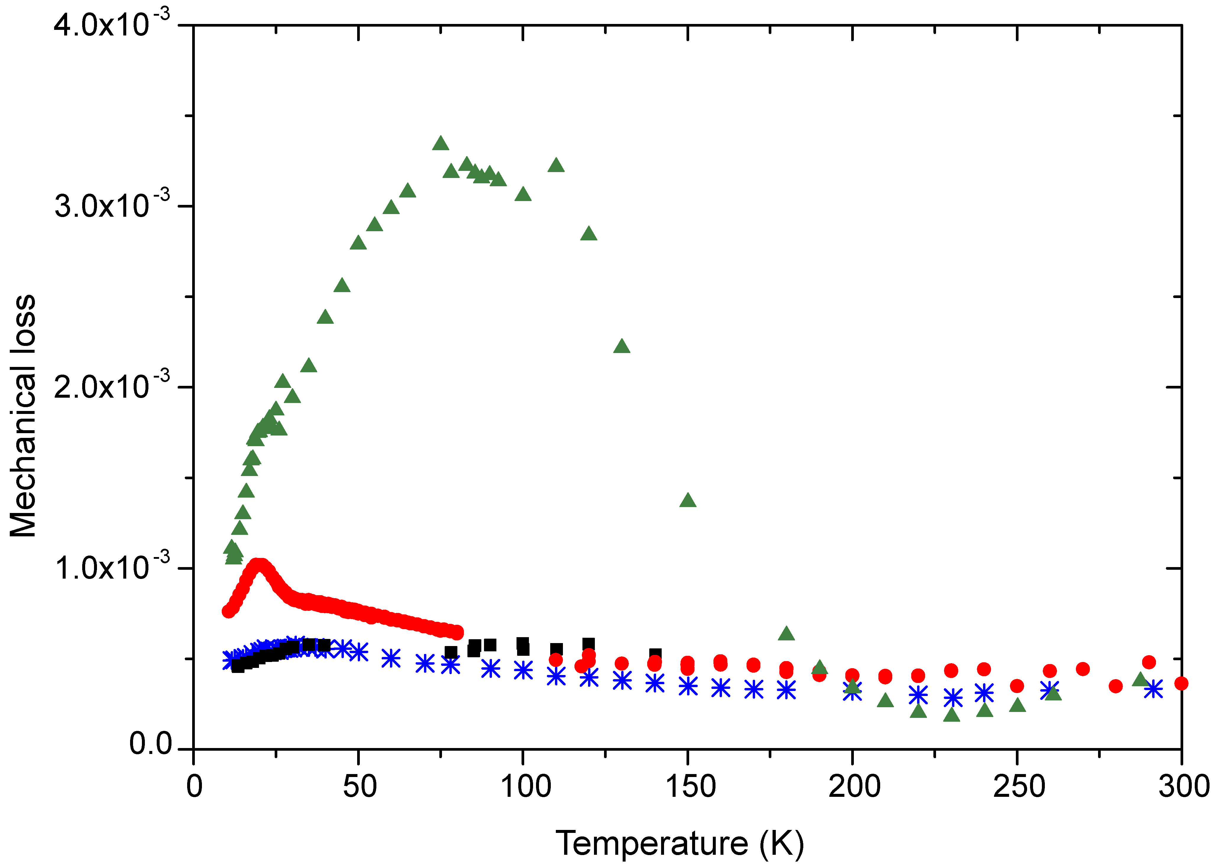
Effect of heat treatment temperature on Ta₂O₅ loss
_{800 C}
_{800 C}
_{800 C}
_{800 C}
_{800 C}
_{800 C}
_{800 C}
_{800 C}
_{800 C}
_{(i)}
_{600 C}
_{600 C}
_{600 C}
_{600 C}
_{600 C}
_{600 C}
_{600 C}
_{400C}
_{400C}
_{400C}
_{400C}
_{300C}
_{300C}
Loss at 1.9 kHz of 0.5 μm thick un-doped Ta₂O₅ coatings heat treated at 300, 400, 600 and 800 C. (Coatings from CSIRO)
Three loss peaks, triggered at different post-deposition heat-treatment temperatures

Slide 55
Effect of heat treatment temperature on Ta₂O₅ loss
_{300 C}
_{800 C}
_{800 C}
_{800 C}
_{800 C}
_{800 C}
_{800 C}
_{800 C}
_{800 C}
_{800 C}
_{800 C}
_{600 C}
_{(i)}
_{600 C}
_{600 C}
_{600 C}
_{600 C}
_{600 C}
_{600 C}
_{600 C}
Above: Electron diffraction pattern of Ta₂O₅ heat treated at 600 C
Left: Loss at 1.9 kHz of 0.5 μm Ta₂O₅ coatings annealed at 300, 400, 600 and 800 C.
_{400C}
_{400C}
_{400C}
_{400C}
_{400C}
_{300C}
_{300C}
_{300C}
35 K peak
Observed in Ta₂O₅ heat treated at 300, 400 C, and likely in Ta₂O₅ heat treated at 600 C
Activation energy 54 meV
Analogous to dissipation peak in fused silica, involving thermally activated transitions of oxygen atoms?

Slide 56
Effect of heat treatment temperature on Ta₂O₅ loss
_{600 C}
_{800 C}
_{800 C}
_{800 C}
_{800 C}
_{800 C}
_{800 C}
_{800 C}
_{800 C}
_{800 C}
_{800 C}
_{600 C}
_{(i)}
_{600 C}
_{600 C}
_{600 C}
_{600 C}
_{600 C}
_{600 C}
_{600 C}
Above: Electron diffraction pattern of Ta₂O₅ heat treated at 600 C
Left: Loss at 1.9 kHz of 0.5 μm Ta₂O₅ coatings annealed at 300, 400, 600 and 800 C.
_{400C}
_{400C}
_{400C}
_{400C}
_{400C}
_{300C}
_{300C}
_{300C}
18 K peak
Observed in Ta₂O₅ heat treated at 600 C and 800 C
Related to structural changes brought on by heat treatment close to crystallisation temperature?

Slide 57
Effect of heat treatment temperature on Ta₂O₅ loss
_{800 C}
_{800 C}
_{800 C}
_{800 C}
_{800 C}
_{800 C}
_{800 C}
_{800 C}
_{800 C}
_{800 C}
_{800 C}
_{800 C}
_{600 C}
_{(i)}
_{600 C}
_{600 C}
_{600 C}
_{600 C}
_{600 C}
_{600 C}
_{600 C}
Above: Electron diffraction pattern of Ta₂O₅ heat treated at 800 C
Left: Loss at 1.9 kHz of 0.5 μm Ta₂O₅ coatings annealed at 300, 400, 600 and 800 C.
_{400C}
_{400C}
_{400C}
_{400C}
_{400C}
_{300C}
_{300C}
_{300C}
90 K peak
Observed in coating heat treated at 800 C
Large, broad loss peak likely to be related to (expected) onset of polycrystalline structure due to high temperature heat treatment. Loss mechanism could be e.g. phonon scattering at grain boundaries

Slide 58
Loss of silica coatings
Scatter at higher temperatures, possibly due to loss into clamp.
Repeated room temperature measurement of silica coating loss.
Loss of SiO₂ will have a significant contribution to coating thermal noise below 100 K

Slide 59
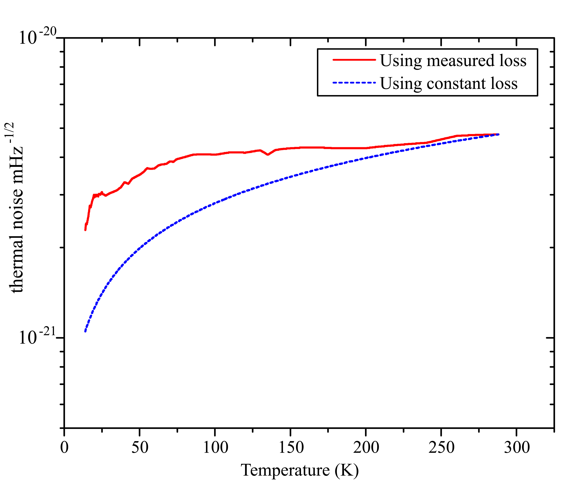
Coating thermal noise at 100 Hz
Using measured coating loss
Using measured coating loss
Optimistic estimate – coating loss remains constant at all T
Optimistic estimate – coating loss remains constant at all T
If coating loss was constant with temperature, could gain factor of ~ 4 in TN at 18 K
Measured coating losses imply we can only gain a factor of ~ 1.7 in coating TN by cooling to 18 K

Slide 60
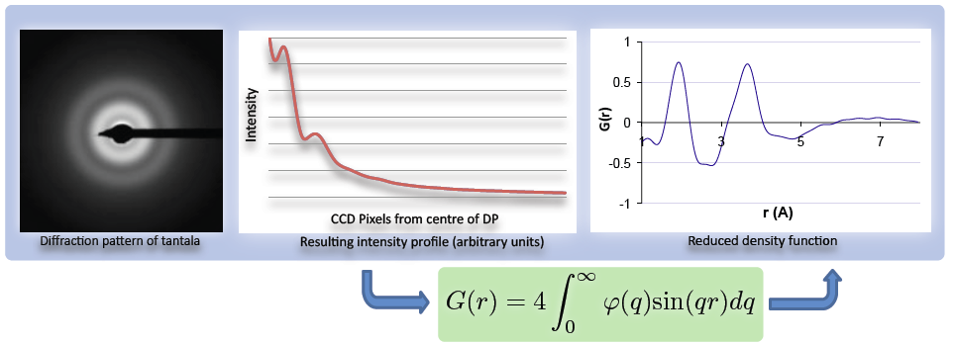
Probing links between atomic structure and loss
Short range structure of amorphous materials probed by Reduced Density Function analysis of TEM electron diffraction data
RDF is a Fourier transform of the information gained from the intensity profile of a diffraction pattern
RDF gives statistical representation of where atoms are located with respect to a central atom

Slide 61
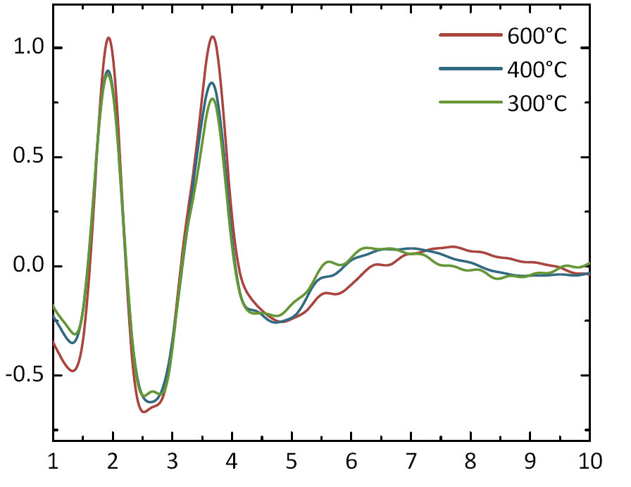
The Reduced Density Function (RDF)
Ta O distance
Ta Ta distance
G(r)
G(r)
G(r)
G(r)
r (Å)
RDFs of heat-treated tantala coatings¹
Interpreting RDFs
Peak position - nearest neighbour distances
Peak height – nearest neighbour abundances
Peak width – indicates level of order in structure

Slide 62
Structural modelling
RDF can be used as basis for Reverse Monte Carlo models of the microstructure, allowing e.g. bond angle distributions to be extracted
Molecular dynamics simulations used to ensure models are energetically stable
Distribution
Bond angle (degrees)
Ta – blue O - red

Slide 63
Current / future coatings research
Alternative high-index coating materials e.g. amorphous Si, hafnia
Alternative low-index materials e.g. Al₂O₃
Exploring links between short-range atomic structure and loss
Reduced coating / coating-free optics – diffractive optics and resonant waveguide mirrors

Slide 64
Optical Properties

Slide 65
Important Properties
refractive index n → influences coating selection
thermo-refractive coefficient dn/dT → governs the thermo-refractive noise
optical absorption α → limits the operation at low temperatures and at high laser powers
all these parameters are needed at low temperatures!

Slide 66
Research on the refractive index of Si at low temperatures
classical prism experiment needed to determine refractive index
method of minimum deviation with high resolution cryogenic actuators
method of minimum deviation
in Littrow-order
experimental setup for cryogenic
measurements of the refractive index
A – laser, B – beam splitter, C – Faraday isolator, D – cryostat, E- prism, F- detector

Slide 67
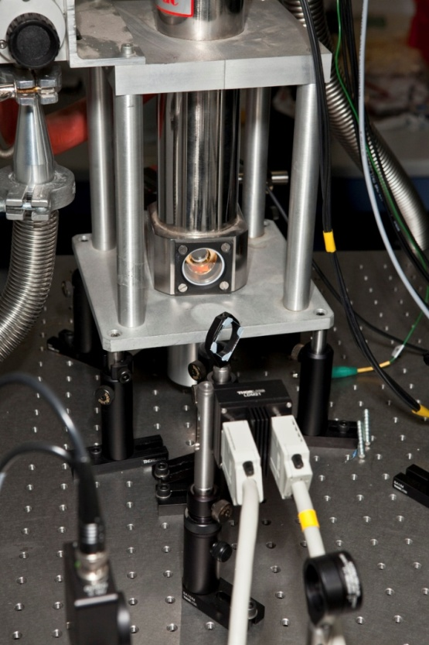
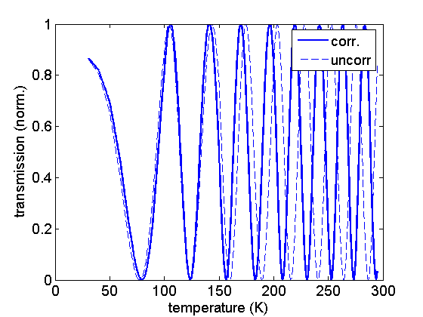
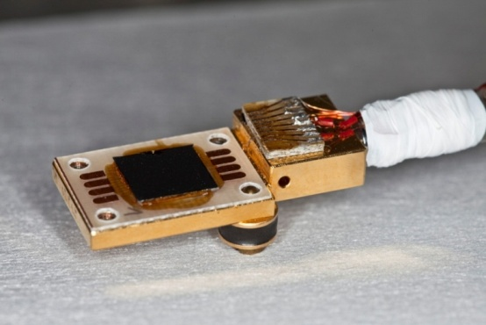
Research on the thermo-refractive coefficient of Si
incoming light
outcoming light
internal reflections
Fabry-Perot-Cavity
filled with silicon, dn/dT
determines optical path
length inside FPC

Slide 68
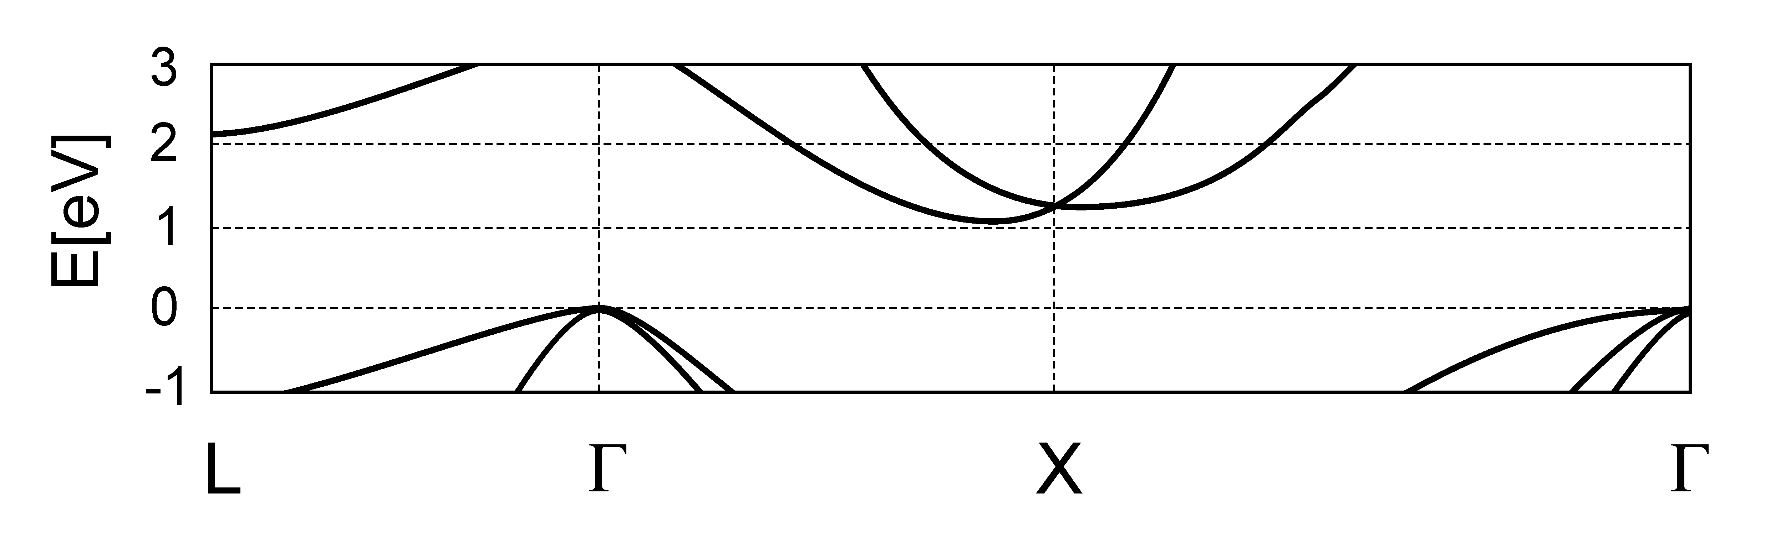
Research on the optical absorption of silicon at low T.
simplified electronic band structure
k
CB
VB
direct transition
indirect transition
phonon contribution
Δk = 0
photons do not
carry momentum
Δk = k_{phonon}
E_{photon} + E_{phonon} = E
photons with E < E_{gap}=1.1eV can be
absorbed by assistance of phonons

Slide 69
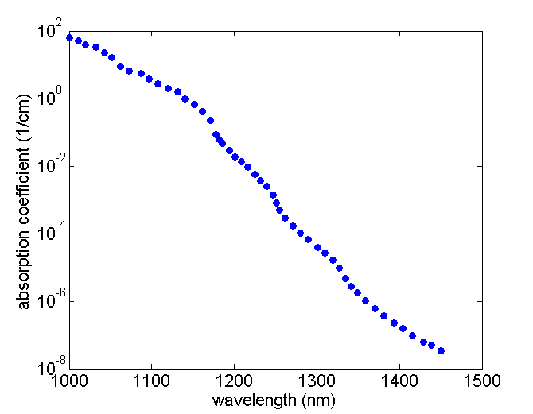
Research on the optical absorption of silicon at low T.
1 phonon
2 phonons
phonon
3 phonons
photon
300 K
[Keeves et al., J. Appl. Phys.]
density of phonons is strongly temperature dependent
much smaller absorption can be expected at low temperatures
→ measurements ongoing

Slide 70
Summary

Slide 71
What have we learned?
material properties strongly determine the thermal noise performance of a detector
simple temperature scaling is dangerous and leads to wrong results
impurities determine mechanical losses → strong influence on thermal noise
material science (understanding temperature behaviour of parameters) is needed to optimise future detectors
a wide and open field…

